Slide 1
Software quality Engineering PRESENTATION
Presented by:
Muhammad Memooon(20-SE-030)
Sabha Rani(20-SE-032)
Muhammad Huzaifa(20-SE-045)
(CAFETERIA ORDERING SYSTEM)

Slide 2
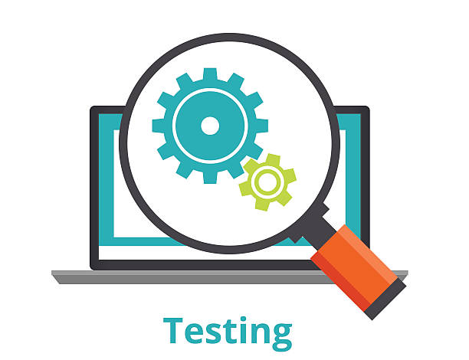







Table of contents
INTRODUCTION
TYPES OF TESTING
STRATEGIC APPROACH
TEST PLAN
TEST CASES
TEST PLAN ACTVITIES
TEST EXECUTION
TEST REPORT

Slide 3
Introduction
Software testing is a critical process in software development that involves assessing a software application to identify defects and ensure it meets requirements.
It includes designing and executing test cases, comparing actual and expected results, and employing various testing techniques.
By uncovering issues, testing improves software quality and user satisfaction.

Slide 4
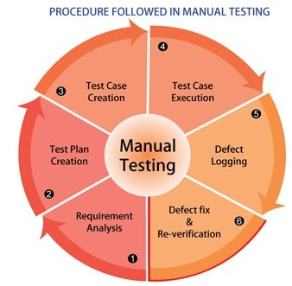
STRATEGIC APPROACH

Slide 5
A test plan in software quality engineering is a comprehensive document that outlines the objectives, scope, approach, and schedule of the testing activities for a software application or system. It defines the specific goals, testing techniques, and levels of testing to be performed. The test plan also includes information about the test environment, required resources, deliverables, risks, and exit criteria for the testing phase. It serves as a roadmap for the testing process, ensuring that all necessary activities are conducted efficiently and effectively to achieve the desired quality standards for the software.
TEST PLAN

Slide 6
Test Plan Activities
Defining
Test Schedule
Test Deliverables
Test Resources
Stakeholder Review and Approval
Test Execution

Slide 7
Test cases
Account creation
Search Bar
Place Order
Previous Orders
Payment Option
Payment Confirm
Payment Deduct
Update Menu and Inventory
Create Menu
Modify Menu
Delete menu
View menu
Feedback submission
Display Feedback to Admin

Slide 8


Types of testing
Black box testing
White box testing
Functional Testing
Integration Testing
System Testing
Regression Testing
User Acceptance Testing
Performance Testing
Security Testing
Usability Testing
Compatibility Testing
Exploratory Testing
Unit Testing
Integration Testing
Statement Coverage Testing
Branch Coverage Testing
Path Coverage Testing
Condition Coverage Testing

Slide 9
Test Execution
Test execution refers to the process of running and executing the planned test cases or test scripts against the software application or system under test. It is a crucial phase of the testing lifecycle where the actual tests are executed to validate the behavior, functionality, and performance of the software.

Slide 10
Test Execution
Test Environment Setup
Test Data Preparation
Test Case Execution
Test Case Logging
Defect Reporting
Test Result Analysis

Slide 11
THANK YOU

